Slide 1
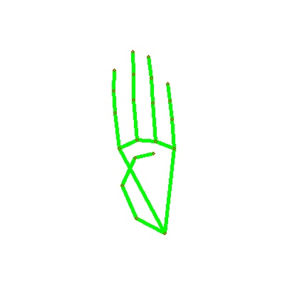
Conversion of Sign Language to Text

Slide 2
CONTENT
Abstract
Introduction
Software Requirement
Overview
Approach
Pre-Processing Data (Testing)
Model Building
Result
Future Enhancement
Conclusion

Slide 3
Abstract
Our project aims to create a computer application that trains a model to recognize hand gestures of American Sign Language from real-time video and display the corresponding sign in text format on the screen. This system is designed to assist deaf and mute individuals by providing a tool for effective communication and bridging the gap between sign language users and non-signers.

Slide 4
Introduction
Today, nearly 2 million deaf and mute individuals face significant communication challenges, relying solely on sign language.
Innovative Solution: Our project utilizes Image Processing and CNNs to develop advanced technologies.
Primary Aim: To bridge the communication gap by creating an automatic sign language translation system, enhancing accessibility for both signers and non-signers.

Slide 5
Software Requirements
Python
MediaPipe
Tensorflow
OpenCV
NumPy
Matplotlib

Slide 6
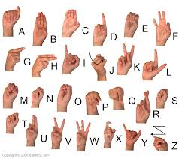
We implemented 27 symbols(A-Z, blank) of ASL in our project.

Slide 7
Overview
Develop innovative technologies for seamless communication between sign language users and those relying on spoken and written language. Utilize Image Processing and Convolutional Neural Networks (CNN) for accurate interpretation and conversion of sign language gestures. Enhance accessibility and inclusivity by creating systems that convert sign language into both written text and audible speech.

Slide 8
APPROACH
The project adopts a user-friendly interface for efficient addition and training of new gestures. Leveraging Convolutional Neural Networks, it classifies 26 gestures through 100 images each. Real-time translation occurs by recording and matching sign language gestures. The approach integrates advanced technologies for holistic communication solutions, emphasizing efficiency and adaptability in design.

Slide 9
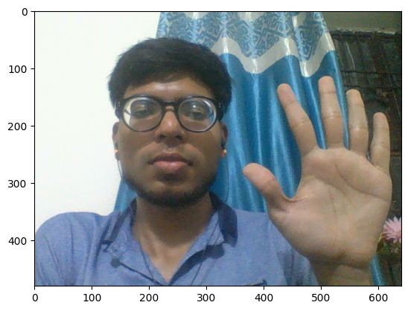
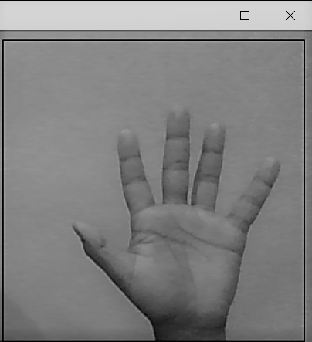
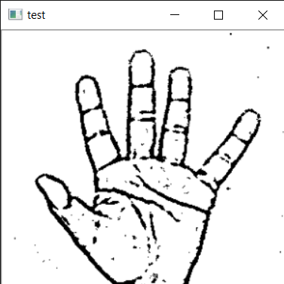
Image Preprocessing
Image Post Gaussian Blur
Capturing Raw Image
Gray Scale Image

Slide 10
Data Pre-processing
Histogram Creation:
  Utilizes OpenCV to generate a histogram, separating hand gestures from the background. 2. 50 squares in a 5x10 grid are displayed, and the hand must cover all squares before capturing the image.
Image Modifications:
  Resizes captured images to 50x50 pixels and converts them to grayscale. 2. Each image is flipped along the vertical axis for diverse training data.
3. Convolution:
  Applies convolution with feature detectors to create feature maps for efficient feature detection.
  The main aim is to identify and highlight relevant features in the gesture images.

Slide 11
4. ReLu Layer:
  Passes the convoluted image through the Rectifier function to increase non-linearity.
  Enhances the features extracted from the image, preparing them for further processing.
5. Max Pooling:
  Selects the maximum value in small grids, reducing data size and preserving essential features.
  Resolves issues related to variations in feature size and orientation.
6. Flattening:
  Flattens the pooled image features to transform them into columns.Prepares the data for input into the Artificial Neural Network

Slide 12
MODEL BUILDING & LAYER
Convolutional Neural Network (CNN):
  The primary architecture used for both image classification and feature extraction. It processes the pre-processed gesture images using convolutional layers that detect and learn relevant features (edges, shapes, textures) from the data.
Activation Function - ReLU Layer:
  After each convolution operation, the Rectified Linear Unit (ReLU) is applied to introduce non-linearity, enabling the network to capture complex patterns and relationships in the gesture features.
.

Slide 13
Max Pooling Layer:
  This layer reduces the size of the data by selecting the maximum value within small grids from the feature maps. It aims to retain the most essential features while discarding redundant information, making the model more efficient.
Flattening Layer:
  The output from the max pooling layer is flattened into a one-dimensional array to prepare it for input into the artificial neural network (ANN). This step makes the data usable for the fully connected layers in the ANN.
Artificial Neural Network (ANN):
  The fully connected layers in the ANN perform complex pattern recognition. The flattened features from the CNN are fed into these layers, allowing the network to make predictions and classify the sign language gestures.
Output Layer:
  The final layer produces the output, which represents the classification or label of the sign language gesture. The number of nodes in this layer corresponds to the total number of gesture categories defined in the dataset

Slide 14
RESULT
Precision Translations:
Sign language accurately translated into English alphabet characters. 2. Successful outputs demonstrate precise concatenation for word formation.
Effectiveness of Convolutional and Dense Layers: 1. Convolutional and dense layers capture spatial features and complex relationships effectively. 2. Model proficiency validated through coherent and accurate output.
Continuous Monitoring Importance: 1. Ongoing evaluation through confusion matrix and metrics essential for model robustness. 2. Fine-tuning and optimization based on analysis contribute to refinement.

Slide 15
FUTURE ENHANCEMENT
LSTM Networks for Sequential Gestures:
  Use LSTM to recognize dynamic gesture sequences, improving accuracy for complex signs over time.
Mobile & Web App Deployment:
  Develop cross-platform apps for smartphones and web browsers to make the solution widely accessible.
Multimodal Integration:
  Add facial expression and body posture recognition to enhance overall gesture understanding.

Slide 16
CONCLUSION
In this report, a functional real time vision based american sign language recognition for D&M people have been developed for asl alphabets.
We achieved an accuracy of 98.00% on our dataset.
Prediction has been improved after implementing two layers of algorithms in which we verify and predict symbols which are more similar to each other.

Slide 17
Project Under Supervision of
Dr. R.K.Sharma
Contribution By
Kartik Saini (2021UEA6504)
Deepak Kumar (2021UEA6511)
Lakshaya Singh (2021UEA6522)
Yash Rajora (2021UEA6562)

Slide 18
ThankYou

